Slide 1

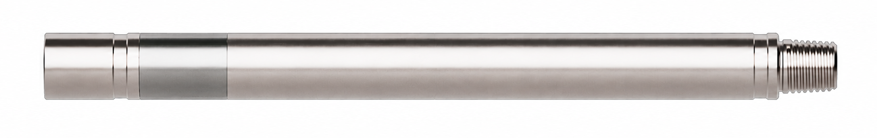
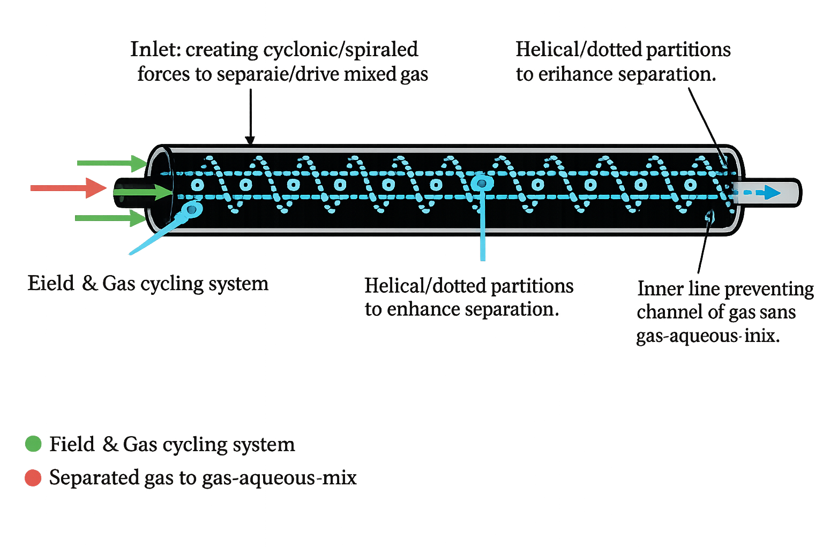


Reach Farther
with unrivalled products
and engineering services.
Gas Separator
Enables WWT Tractors and other down hole tools to operate safely with multiphase fluids. Ideal for underbalanced well applications or any comingled fluid operations.
The Downhole Gas Separator enables the Coiled Tubing Tractor to operate reliability with nitrified and multiphase fluids by efficiently separating nitrogen gas to annulus.
Enables safe operation of the tractor with commingled fluid (fluid and gas) for underbalanced wells or any comingled fluid operations
Provides operational flexibility by working with both multiphase and single-fluid systems without requiring BHA changes.
Efficient design removes 80–90% of nitrogen gas before it reaches the lower BHA
Max Tensile (lb) | 66,500
Bending Radius (ft) | 120
Max OD (in) | 2.875
Min ID (in) | 0.446
Length (in) | 101
Min Flow Area (in ²) | 0.625 (two phase) 0.196 (gas phase)
WWT International supports your operations
from start to ﬁnish with full-service onsite
mobilization and support 24/7.
To ﬁnd out more, visit: www.wwtco.com
© 2026 WWT North America Holdings, Inc. All rights reserved.
WWT International is a registered trademark of WWT North America Holdings, Inc.

